Slide 1
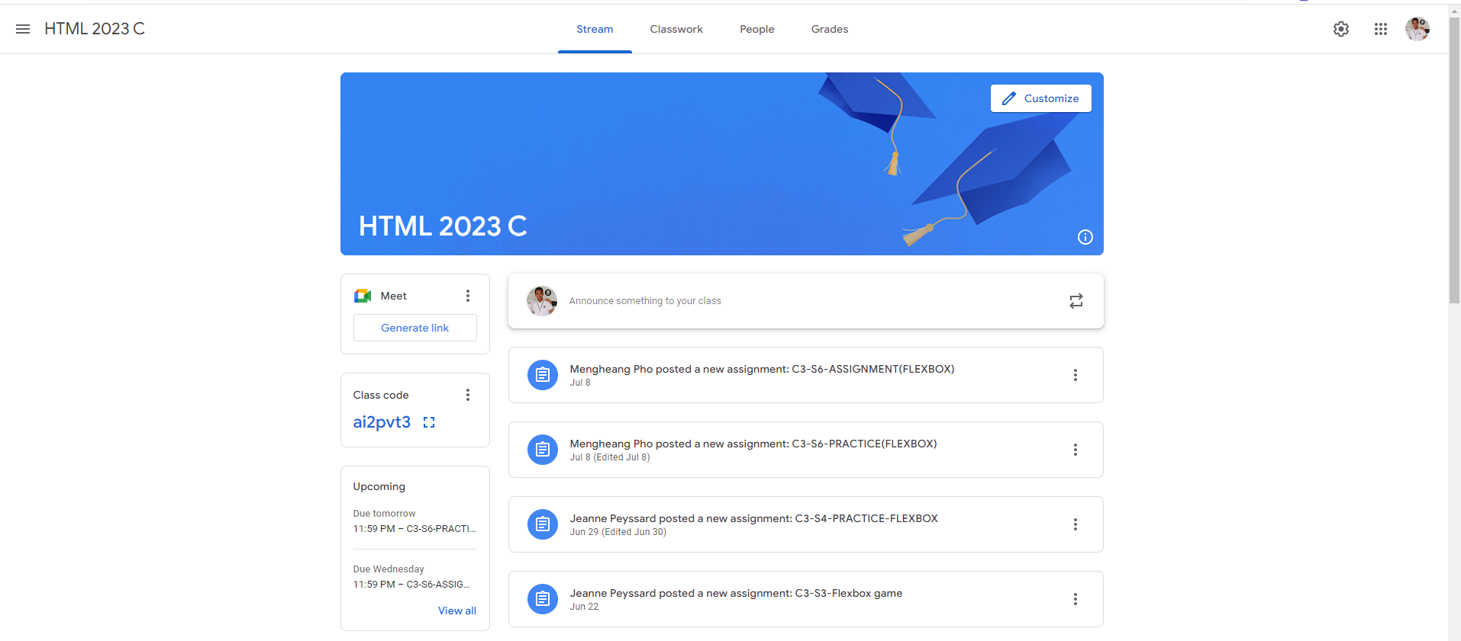
Identify root components of website below

Slide 2
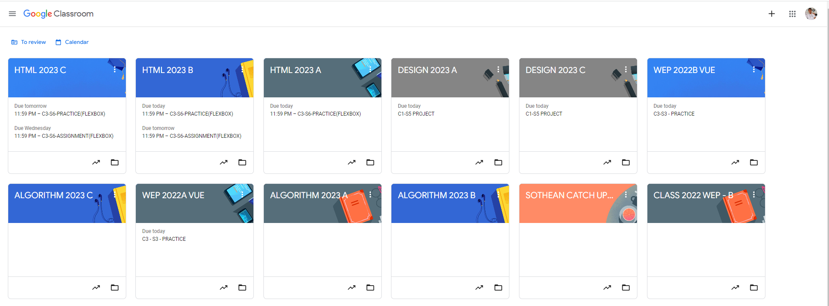
Root div
- Height: 100vh
content
nav
Flex: 0
header
Flex: 0
Flex: 1

Slide 3
content
nav
header
Content

Slide 4
Content
div Container
Flex-direction: row
Content
Left Div
Right Div

Slide 5
Container
Flex-direction: Column
Content
Div
Div
Div
Div

Slide 6
Container
Flex-direction: Column
Content
Div
Div
Div
Div
Div

